Slide 1
Psychosocial History
Artem Gindin
Berly Jaison

Slide 2
What do we mean by “psychosocial history”?
Social & psychological aspects of a person’s life such as:
Cognitive function
Emotional health
Social history
Support System
Financial & Legal issues
Spirituality
Elderly Mistreatment
Notes:
Social: alcohol, tobacco, recreational drugs, nutrition, exercise

Slide 3
How to assess cognitive function?
Mini Mental Exam:
Orientation
Registration
Attention & Calculation
Recall
Language
Notes:
Orientation: Month, Day, Year, Season, Date
Where are we? State, country, town, hospital/ floor

Slide 4
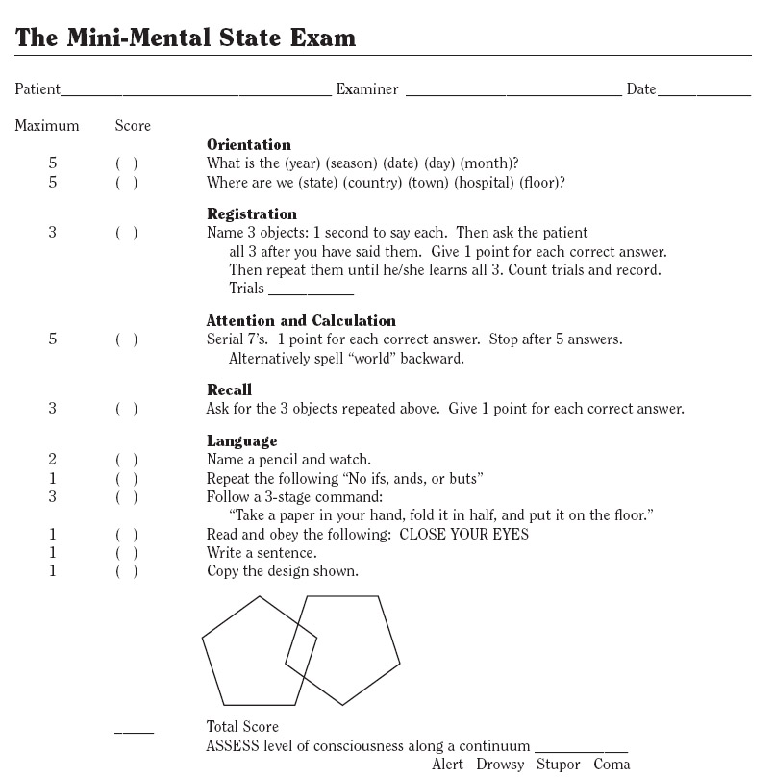
Notes:
25-30 Normal aging or borderline dementia
23 or less: high likelihood of dementia

Slide 5
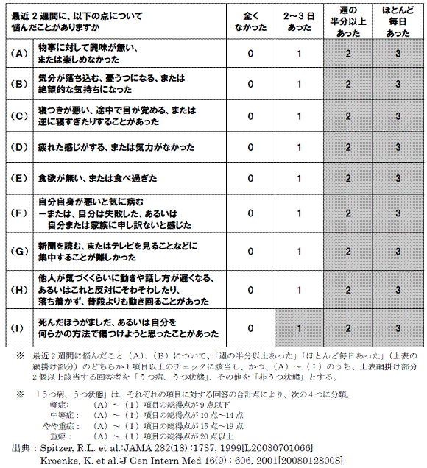
Emotional Health

Slide 6
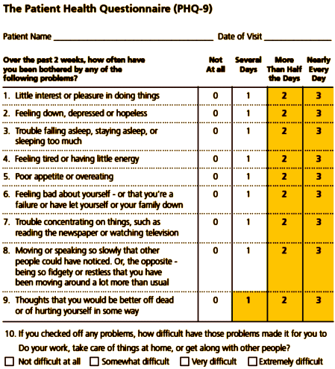
Notes:
4 checks in the shaded area: consider a depressive disorder
Atleast 5 checks in the shaded section: consider major depressive disorder: clinical depression
2-4 checks in the shaded section: consider other forms of depression: postpartum, seasonal affective

Slide 7
Social History
Alcohol Abuse – “CAGE”
Tobacco
Recreational Drugs
Nutrition & Exercise
Bladder Incontinence/Hearing/Vision
Education
Housing
Transportation
Notes:
CAGE:
1. Have you felt the need to Cut down on your drinking?
2. Do you feel Annoyed by people complaining about your drinking?
3. Do you ever feel Guilty about your drinking?
4. Do you ever drink an Eye-opener in the morning to relieve the shakes?
Two or more affirmative responses suggest that the client is a problem drinker.
Patients or caregivers may acknowledge clothes fitting more loosely or belts notched
more tightly. Diet diaries can give useful data about food intake.
Transportation – make sure they are able to drive. How is there driving. In NYS. You may or may not report their driving

Slide 8
Support System
Residence
Alone
With family
Nursing home
Assisted Living
Hospice

Slide 9
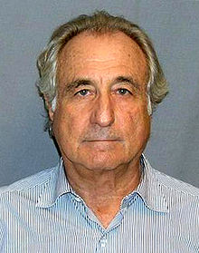
Financial & Legal Issues
Medical Bills
Be cost efficient
Debt
Gambling, mortgage, credit cards
Family

Slide 10
Spirituality
Be aware of different religions and religious practices

Slide 11
Elderly Mistreatment
Physical
Psychological/ Emotional
Financial Abuse
Sexual Abuse
Scams
Neglect
Notes:
One study suggests that around 25% of vulnerable older adults will report abuse in the previous month, totaling up to 6% of the general elderly population.^{[21]} However, some consistent themes are beginning to emerge from interaction with abused elders, and through limited and small scale research projects. Work undertaken in Canada suggests that approximately 70% of elder abuse is perpetrated against women and this is supported by evidence from the AEA helpline in the UK, which identifies women as victims in 67% of calls. Also domestic violence in later life may be a continuation of long term partner abuse and in some cases, abuse may begin with retirement or the onset of a health condition.^{[22]} Certainly, abuse increases with age, with 78% of victims being over 70 years of age.^{[23]}
^{Risk factors}
Has memory problems (such as dementia)
Has physical disabilities
Has depression, loneliness, or lack of social support
Abuses alcohol or other substances
Is verbally or physically combative with the caregiver
Has a shared living situation

Slide 12
Case Study
Mr. Jones, 79 yo retired lawyer, residing in Williamsville
Barely meets monthly expenses
Living alone in his 4 bedroom home
Paying for medications and co-pays for medical visits to manage Parkinson’s, diabetes and hypertension
Son asks for money for investments
Married 52 years: wife died 6 months ago
No family or friends in the area
Children live in NYC, occasionally visit
Most friends passed away
Stopped going for walks after wife died
Each night, alone in his kitchen, he sips several glasses of red wine and ponders the meaning of life

Slide 13
Psychosocial Problems
Financial stress
Grief from loss
Social isolation
Depression
Possible suicidal ideation

